Slide 1
W4111 – Introduction to Databases Section 002, Spring 2025 Lecture 5: ER(4), Relational(4), SQL(4)
© Donald F. Ferguson, 2025

Slide 2

Today’s Contents
2 | COMS W4111_002_2025_1 - Lecture 5: ER(4), Relational(4), SQL(4) © Donald F. Ferguson, 2025

Slide 3
Contents
Introduction and course updates
Some of Codd’s 12 Rules: Information Rule, Online Catalog, View Update

Slide 4
Introduction and course updates
4 | COMS W4111_002_2025_1 - Lecture 5: ER(4), Relational(4), SQL(4) © Donald F. Ferguson, 2025

Slide 5
Course Updates
Codd’s 12 Rules
Midterm Exam
18-OCT in the classroom from 10:10 to 11:30.
Written exam “on paper.”
No electronics.
We will document what paper, books, etc. you can use for “open book.”

Slide 6
Codd’s 12 Rules
6 | COMS W4111_002_2025_1 - Lecture 6: ER(5), Relational(5), SQL(5) © Donald F. Ferguson, 2025

Slide 7
Introduction
Introduction
7 | COMS W4111_002_2025_1 - Lecture 5: ER(4), Relational(4), SQL(4) © Donald F. Ferguson, 2025

Slide 8

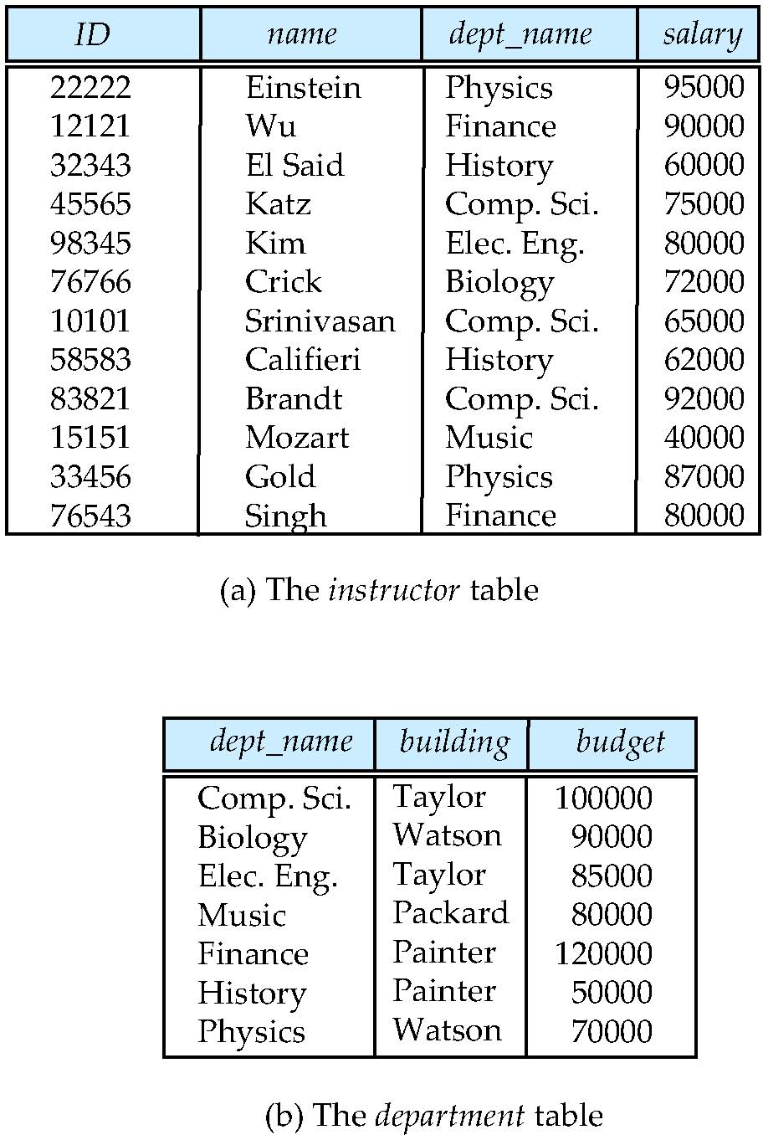
Relational Model
All the data is stored in various tables.
Example of tabular data in the relational model
Columns
Ted Codd Turing Award 1981
Rows
Notes:
8

Slide 9
Codd’s 12 Rules
Rule 1: Information Rule
The data stored in a database, may it be user data or metadata, must be a value of some table cell. Everything in a database must be stored in a table format.
Rule 2: Guaranteed Access Rule
Every single data element (value) is guaranteed to be accessible logically with a combination of table-name, primary-key (row value), and attribute-name (column value). No other means, such as pointers, can be used to access data.
Rule 3: Systematic Treatment of NULL Values
The NULL values in a database must be given a systematic and uniform treatment. This is a very important rule because a NULL can be interpreted as one the following − data is missing, data is not known, or data is not applicable.
Rule 4: Active Online Catalog
The structure description of the entire database must be stored in an online catalog, known as data dictionary, which can be accessed by authorized users. Users can use the same query language to access the catalog which they use to access the database itself.
Rule 5: Comprehensive Data Sub-Language Rule
A database can only be accessed using a language having linear syntax that supports data definition, data manipulation, and transaction management operations. This language can be used directly or by means of some application. If the database allows access to data without any help of this language, then it is considered as a violation.
Rule 6: View Updating Rule
All the views of a database, which can theoretically be updated, must also be updatable by the system.

Slide 10
Codd’s 12 Rules
Rule 7: High-Level Insert, Update, and Delete Rule
A database must support high-level insertion, updation, and deletion. This must not be limited to a single row, that is, it must also support union, intersection and minus operations to yield sets of data records.
Rule 8: Physical Data Independence
The data stored in a database must be independent of the applications that access the database. Any change in the physical structure of a database must not have any impact on how the data is being accessed by external applications.
Rule 9: Logical Data Independence
The logical data in a database must be independent of its user’s view (application). Any change in logical data must not affect the applications using it. For example, if two tables are merged or one is split into two different tables, there should be no impact or change on the user application. This is one of the most difficult rule to apply.
Rule 10: Integrity Independence
A database must be independent of the application that uses it. All its integrity constraints can be independently modified without the need of any change in the application. This rule makes a database independent of the front-end application and its interface.
Rule 11: Distribution Independence
The end-user must not be able to see that the data is distributed over various locations. Users should always get the impression that the data is located at one site only. This rule has been regarded as the foundation of distributed database systems.
Rule 12: Non-Subversion Rule
If a system has an interface that provides access to low-level records, then the interface must not be able to subvert the system and bypass security and integrity constraints.

Slide 11
Rule 1: Information Rule The data stored in a database, may it be user data or metadata, must be a value of some table cell. Everything in a database must be stored in a table format.
Rule 4: Active Online Catalog
The structure description of the entire database must be stored in an online catalog, known as data dictionary, which can be accessed by authorized users. Users can use the same query language to access the catalog which they use to access the database itself.
Introduction
11 | COMS W4111_002_2025_1 - Lecture 5: ER(4), Relational(4), SQL(4) © Donald F. Ferguson, 2025

Slide 12
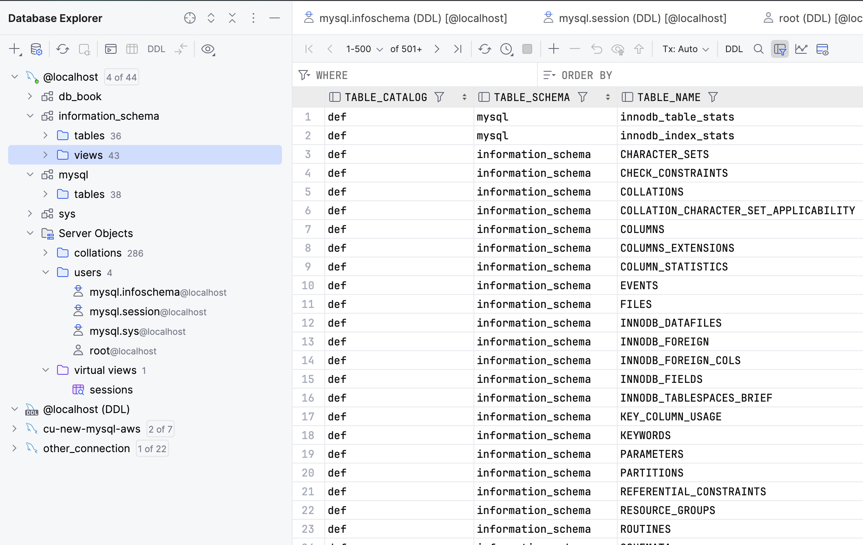
Metadata and System Tables
db_book is a schema that holds “data.”
information_schema is the “online catalog” and holds information about schemas, tables, columns, keys, indexes, ……
mysql: “The mysql schema is the system schema. It contains tables that store information required by the MySQL server as it runs. … (https://dev.mysql.com/doc/refman/8.4/en/system-schema.html)
sys: “MySQL 8.4 includes the sys schema, a set of objects that helps DBAs and developers interpret data collected by the Performance Schema.” (https://dev.mysql.com/doc/refman/8.4/en/sys-schema.html)
Server Objects contains information about sessions, collations, … …

Slide 13
Some Terms
“A database connection is a facility in computer science that allows client software to talk to database server software, whether on the same machine or not. A connection is required to send commands and receive answers, usually in the form of a result set.” (https://en.wikipedia.org/wiki/Database_connection)
Session:
“Connection is the relationship between a client and a MySQL database. Session is the period of time between a client logging in (connecting to) a MySQL database and the client logging out (exiting) the MySQL database.” (https://stackoverflow.com/questions/8797724/mysql-concepts-session-vs-connection)
“A session is just a result of a successful connection.”
Network protocols are layered. You can think of:
Connection as the low-level network connection.
Session is the next layer up and has additional information associated with it, e.g. the user.
Connection libraries like pymysql sometimes blur the distinction.

Slide 14
Concepts
MySQL Workbench
… … … …
DataGrip
Relational Database Management System Instance
Blocks Files Records Offsets … …
SQL commands and result sets flow over connection in a session.
Jupyter Notebook
Logically implements query, update, insert, delete, … operations on tables.
Physical layout managed by the DBMS is not tables and is very different.
Web Application
… …
… …

Slide 15
Switch to Notebook

Slide 16
Data Definition Language (DDL)
Specification notation for defining the database schema
Example: create table instructor ( ID char(5), name varchar(20), dept_name varchar(20), salary numeric(8,2))
DDL compiler generates a set of table templates stored in a data dictionary
Data dictionary contains metadata (i.e., data about data)
Database schema
Integrity constraints
Primary key (ID uniquely identifies instructors)
Authorization
Who can access what
Notes:
16

Slide 17
Metadata and Catalog
‘Metadata is "data that provides information about other data". In other words, it is "data about data". Many distinct types of metadata exist, including descriptive metadata, structural metadata, administrative metadata, reference metadata and statistical metadata.’ (https://en.wikipedia.org/wiki/Metadata)
“The database catalog of a database instance consists of metadata in which definitions of database objects such as base tables, views (virtual tables), synonyms, value ranges, indexes, users, and user groups are stored. ... ... The SQL standard specifies a uniform means to access the catalog, called the INFORMATION_SCHEMA, but not all databases follow this ...” (https://en.wikipedia.org/wiki/Database_catalog)
Codd’s Rule 4: Dynamic online catalog based on the relational model:
The data base description is represented at the logical level in the same way as ordinary data, so that authorized users can apply the same relational language to its interrogation as they apply to the regular data.

Slide 18
Data Dictionary Storage
The Data dictionary (also called system catalog) stores metadata; that is, data about data, such as
Information about relations
names of relations
names, types and lengths of attributes of each relation
names and definitions of views
integrity constraints
User and accounting information, including passwords
Statistical and descriptive data
number of tuples in each relation
Physical file organization information
How relation is stored (sequential/hash/…)
Physical location of relation
Information about indices (Chapter 14)

Slide 19
Relational Representation of System Metadata
Relational representation on disk
Specialized data structures designed for efficient access, in memory

Slide 20
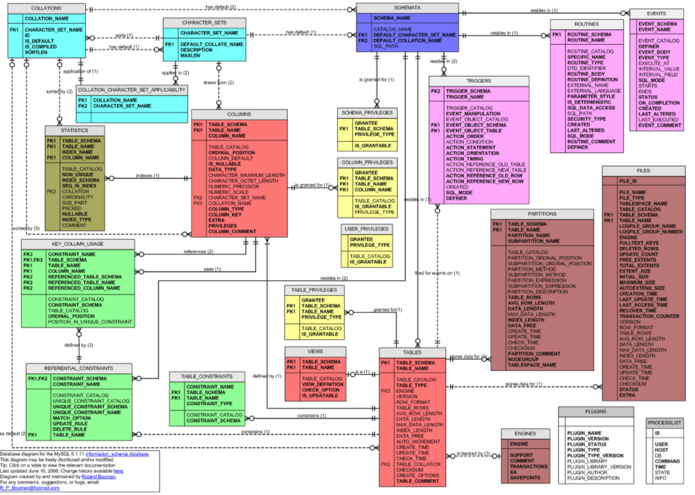
MySQL Catalog (Information_Schema)
Some of the MySQL Information Schema Tables:
'ADMINISTRABLE_ROLE_AUTHORIZATIONS'
'APPLICABLE_ROLES'
'CHARACTER_SETS'
'CHECK_CONSTRAINTS'
'COLUMN_PRIVILEGES'
'COLUMN_STATISTICS'
'COLUMNS'
'ENABLED_ROLES'
'ENGINES'
'EVENTS'
'FILES'
'KEY_COLUMN_USAGE'
'PARAMETERS'
'REFERENTIAL_CONSTRAINTS'
'RESOURCE_GROUPS'
'ROLE_COLUMN_GRANTS'
'ROLE_ROUTINE_GRANTS'
'ROLE_TABLE_GRANTS'
'ROUTINES'
'SCHEMA_PRIVILEGES'
'STATISTICS'
'TABLE_CONSTRAINTS'
'TABLE_PRIVILEGES'
'TABLES'
'TABLESPACES'
'TRIGGERS'
'USER_PRIVILEGES'
'VIEW_ROUTINE_USAGE'
'VIEW_TABLE_USAGE'
'VIEWS'
CREATE and ALTER statements modify the data.
DBMS reads information:
Parsing
Optimizer
etc.

Slide 21
Switch to Notebook

Slide 22
Rule 6: View Updating Rule
All the views of a database, which can theoretically be updated, must also be updatable by the system.
Introduction
22 | COMS W4111_002_2025_1 - Lecture 5: ER(4), Relational(4), SQL(4) © Donald F. Ferguson, 2025

Slide 23
which can theoretically be updated
What are some examples of things that make a view no “updatable?”
Aggregate Functions
SQL INSERT, UPDATE and DELETE affect one row at a time.
Aggregate functions convert multiple rows into one row, which may invove sum, average, … on column values.
How would you map the update of an average to the individual, underlying rows?
The underlying table may have NOT NULL columns that are not in the view ➔ INSERT will not work.
The “project” can merge or transform columns in rows, e.g.
CREATE VIEW cool as SELECT concat(first_name, last_name) as full_name from person.
What would it mean to do an UPDATE on cool.full_name

Slide 24
ER Modeling
24 | COMS W4111_002_2025_1 - Lecture 5: ER(4), Relational(4), SQL(4) © Donald F. Ferguson, 2025

Slide 25
Inheritance
Introduction
25 | COMS W4111_002_2025_1 - Lecture 5: ER(4), Relational(4), SQL(4) © Donald F. Ferguson, 2025

Slide 26
Specialization
Top-down design process; we designate sub-groupings within an entity set that are distinctive from other entities in the set.
These sub-groupings become lower-level entity sets that have attributes or participate in relationships that do not apply to the higher-level entity set.
Depicted by a triangle component labeled ISA (e.g., instructor “is a” person).
Attribute inheritance – a lower-level entity set inherits all the attributes and relationship participation of the higher-level entity set to which it is linked.

Slide 27
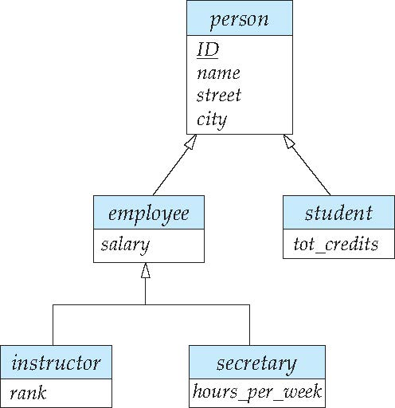
Specialization Example
Overlapping – employee and student
Disjoint – instructor and secretary
Total and partial

Slide 28
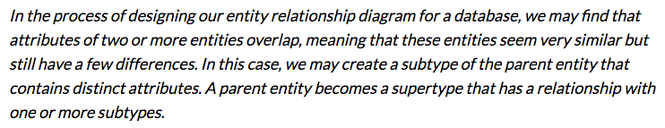
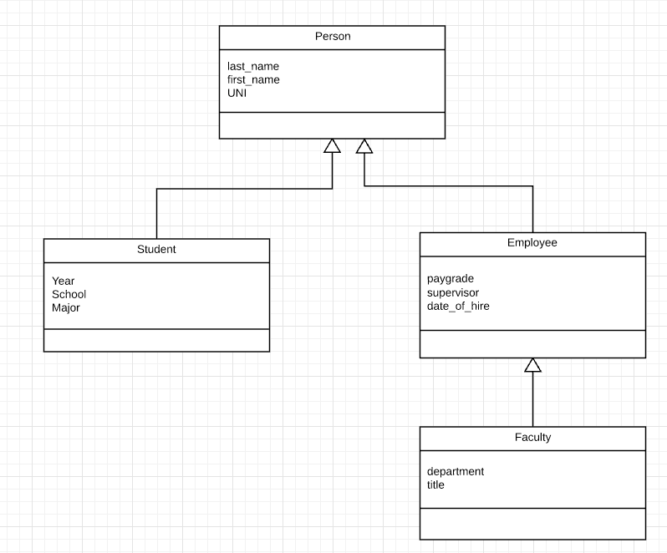
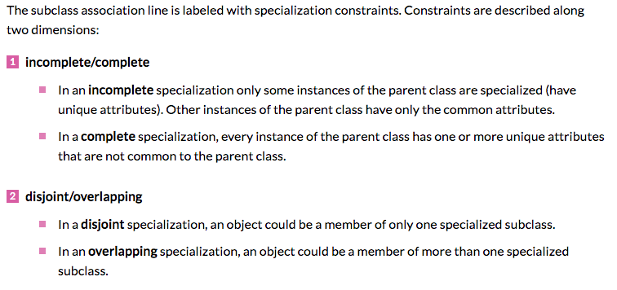
Inheritance/Specialization
Are all employees faculty?
Can students also be employees?
http://www.vertabelo.com/blog/technical-articles/inheritance-in-a-relational-database

Slide 29
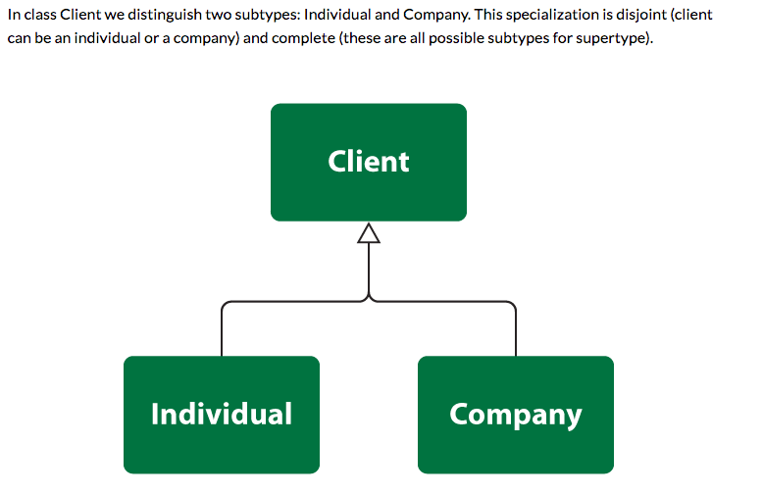
Specialization

Slide 30
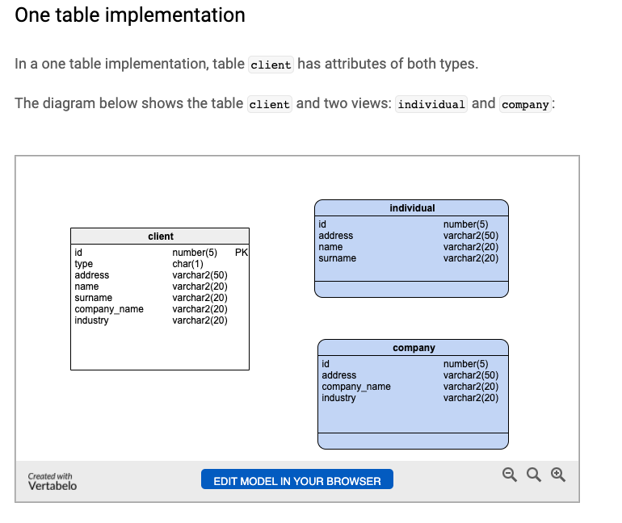
One Table
Views
Tables

Slide 31
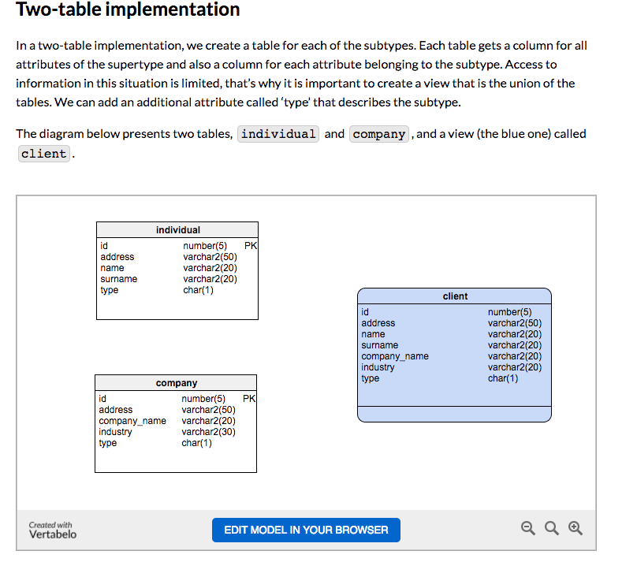
Two Table
View
Tables

Slide 32
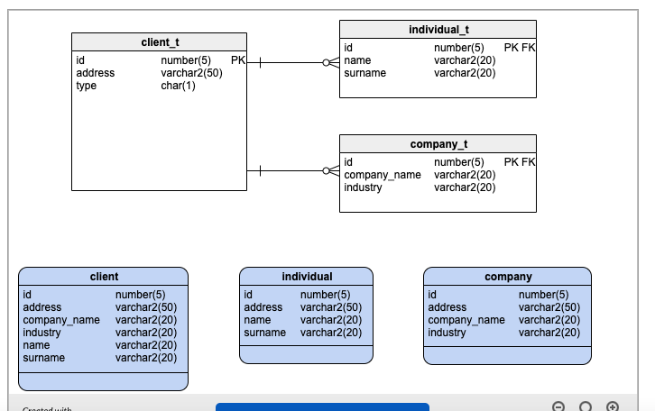
Three Table

Slide 33
Switch to Notebook
Let’s do a quick example.

Slide 34
Complex Attributes
Introduction
34 | COMS W4111_002_2025_1 - Lecture 5: ER(4), Relational(4), SQL(4) © Donald F. Ferguson, 2025

Slide 35
Complex Attributes
Attribute types:
Simple and composite attributes.
Single-valued and multivalued attributes
Example: multivalued attribute: phone_numbers
Derived attributes
Can be computed from other attributes
Example: age, given date_of_birth
Domain – the set of permitted values for each attribute

Slide 36
Composite Attributes
Composite attributes allow us to divided attributes into subparts (other attributes).

Slide 37
Entity Attributes
The relational model and well-designed SQL schema have atomic attributes.
There are several ways to think about attributes:
Simple (Atomic) vs Composite
Single Valued versus Multi-valued
Derived or Not Derived
And, there can be combinations, for example a Composite, Multi-Value Attribute. Phone number is an example:
A phone number is a composite (+1, 914-555-1212)
A customer may have several: work, home, mobile, … …
Examining name_basics from the IMDB dataset is interesting.

Slide 38
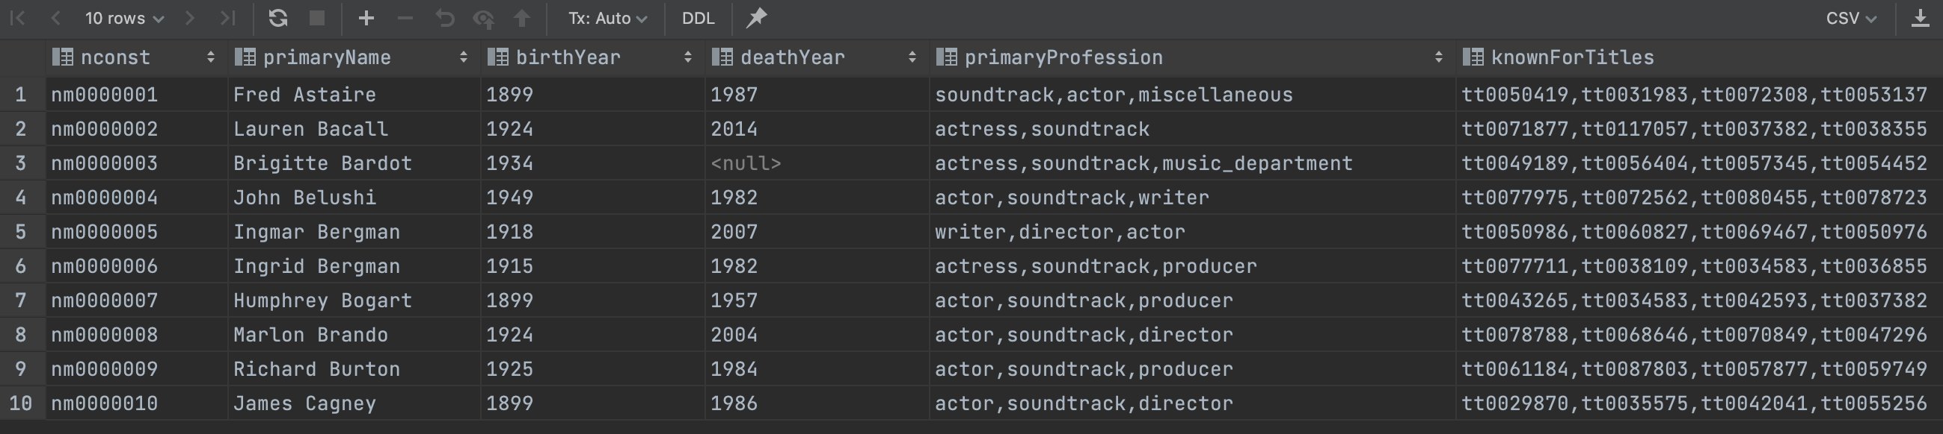
Example from IMDB
Switch to notebook In project template
Consider name_basics
There
Is one composite attribute, primaryName.
Are two multivalued attributes: primaryProfession, knownForTitles
knownForTitles is also tricky, which we will see.
Names are also a little tricky

Slide 39
Degree Cardinality
Introduction
39 | COMS W4111_002_2025_1 - Lecture 5: ER(4), Relational(4), SQL(4) © Donald F. Ferguson, 2025

Slide 40
Degree of a Relationship Set
Binary relationship
involve two entity sets (or degree two).
most relationship sets in a database system are binary.
Relationships between more than two entity sets are rare. Most relationships are binary. (More on this later.)
Example: students work on research projects under the guidance of an instructor.
relationship proj_guide is a ternary relationship between instructor, student, and project

Slide 41
Non-binary Relationship Sets
Most relationship sets are binary
There are occasions when it is more convenient to represent relationships as non-binary.
E-R Diagram with a Ternary Relationship

Slide 42
Mapping Cardinality Constraints
Express the number of entities to which another entity can be associated via a relationship set.
Most useful in describing binary relationship sets.
For a binary relationship set the mapping cardinality must be one of the following types:
One to one
One to many
Many to one
Many to many

Slide 43
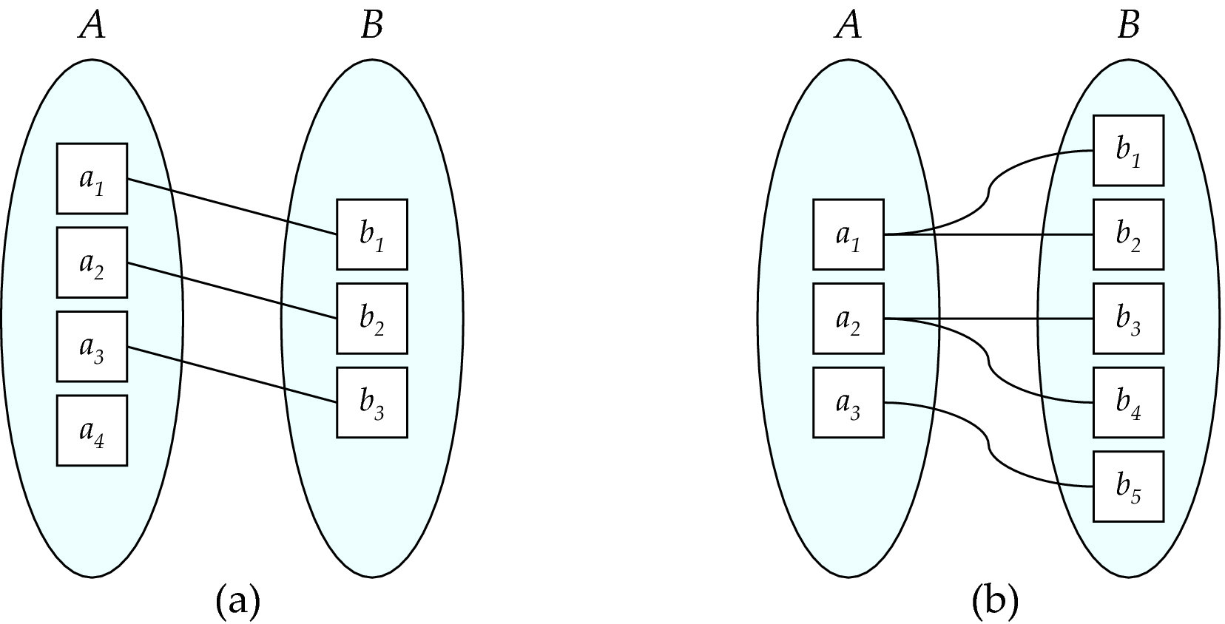
Mapping Cardinalities
One to one
One to many
Note: Some elements in A and B may not be mapped to any
elements in the other set

Slide 44
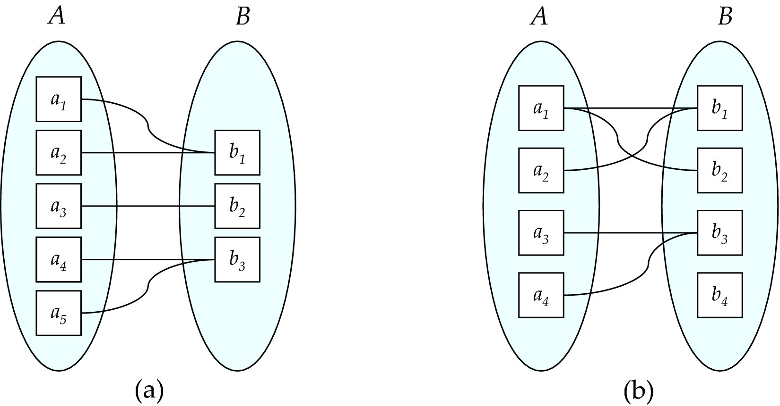
Mapping Cardinalities
Many to one
Many to many
Note: Some elements in A and B may not be mapped to any
elements in the other set

Slide 45
Representing Cardinality Constraints in ER Diagram
We express cardinality constraints by drawing either a directed line (→), signifying “one,” or an undirected line (—), signifying “many,” between the relationship set and the entity set.
One-to-one relationship between an instructor and a student :
A student is associated with at most one instructor via the relationship advisor
A student is associated with at most one department via stud_dept

Slide 46
One-to-Many Relationship
one-to-many relationship between an instructor and a student
an instructor is associated with several (including 0) students via advisor
a student is associated with at most one instructor via advisor,

Slide 47
Many-to-One Relationships
In a many-to-one relationship between an instructor and a student,
an instructor is associated with at most one student via advisor,
and a student is associated with several (including 0) instructors via advisor

Slide 48
Many-to-Many Relationship
An instructor is associated with several (possibly 0) students via advisor
A student is associated with several (possibly 0) instructors via advisor

Slide 49
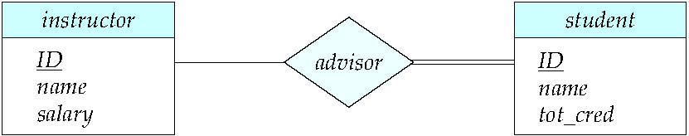
Total and Partial Participation
Total participation (indicated by double line): every entity in the entity set participates in at least one relationship in the relationship set
participation of student in advisor relation is total
every student must have an associated instructor
Partial participation: some entities may not participate in any relationship in the relationship set
Example: participation of instructor in advisor is partial

Slide 50
Notation for Expressing More Complex Constraints
A line may have an associated minimum and maximum cardinality, shown in the form l..h, where l is the minimum and h the maximum cardinality
A minimum value of 1 indicates total participation.
A maximum value of 1 indicates that the entity participates in at most one relationship
A maximum value of * indicates no limit.
Example
Instructor can advise 0 or more students. A student must have 1 advisor; cannot have multiple advisors

Slide 51
Aggregation
Introduction
51 | COMS W4111_002_2025_1 - Lecture 5: ER(4), Relational(4), SQL(4) © Donald F. Ferguson, 2025

Slide 52
Aggregation
Consider the ternary relationship proj_guide, which we saw earlier
Suppose we want to record evaluations of a student by a guide on a project

Slide 53
Aggregation (Cont.)
Relationship sets eval_for and proj_guide represent overlapping information
Every eval_for relationship corresponds to a proj_guide relationship
However, some proj_guide relationships may not correspond to any eval_for relationships
So we can’t discard the proj_guide relationship
Eliminate this redundancy via aggregation
Treat relationship as an abstract entity
Allows relationships between relationships
Abstraction of relationship into new entity

Slide 54
Aggregation (Cont.)
Eliminate this redundancy via aggregation without introducing redundancy, the following diagram represents:
A student is guided by a particular instructor on a particular project
A student, instructor, project combination may have an associated evaluation
The simplest way to handle in relational is an associative entity.
Some thoughts here: https://www.geeksforgeeks.org/aggregate-data-model-in-nosql/
Notes:
54

Slide 55
Reduction to Relational Schemas
To represent aggregation, create a schema containing
Primary key of the aggregated relationship,
The primary key of the associated entity set
Any descriptive attributes
In our example:
The schema eval_for is:
eval_for (s_ID, project_id, i_ID, evaluation_id)
The schema proj_guide is redundant.

Slide 56
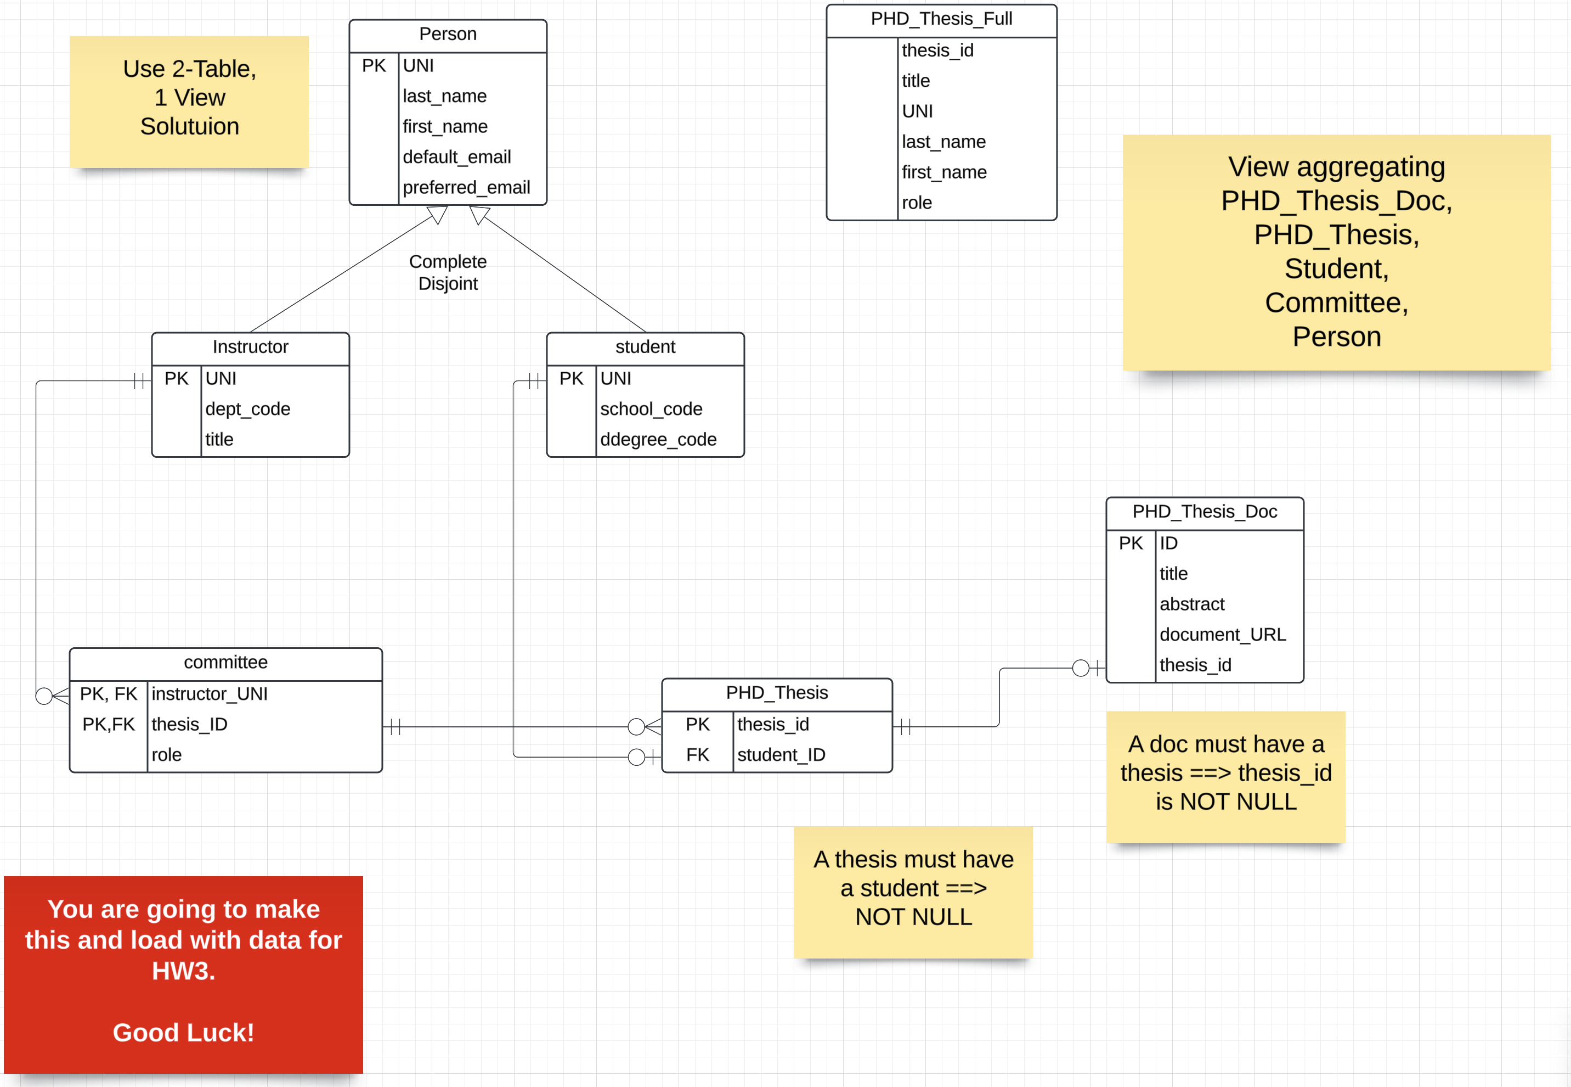
Let’s Do an Example in Crow’s Foot
If I got that right, it is a miracle. Normally, you cannot be sure until you implement and test it.

Slide 57
Since we did some data engineering, let’s take a look at a REST Web Application … …

Slide 58
REST
58 | COMS W4111_002_2025_1 - Lecture 5: ER(4), Relational(4), SQL(4) © Donald F. Ferguson, 2025

Slide 59
Data Modeling Concepts and REST
Almost any data model has the same core concepts:
Types and instances:
Entity Type: A definition of a type of thing with properties and relationships.
Entity Instance: A specific instantiation of the Entity Type
Entity Set Instance: An Entity Type that:
Has properties and relationships like any entity, but ...
Has at least one special relationship – contains.
Operations, minimally CRUD, that manipulate entity types and instances:
Create
Retrieve
Update
Delete
Reference/Identify/... ...
Host/database/table/pk

Slide 60
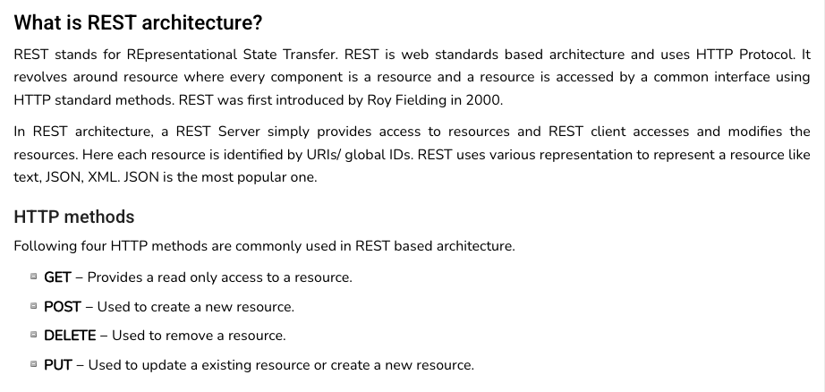
REST (https://www.tutorialspoint.com/restful/restful_introduction.htm)

Slide 61
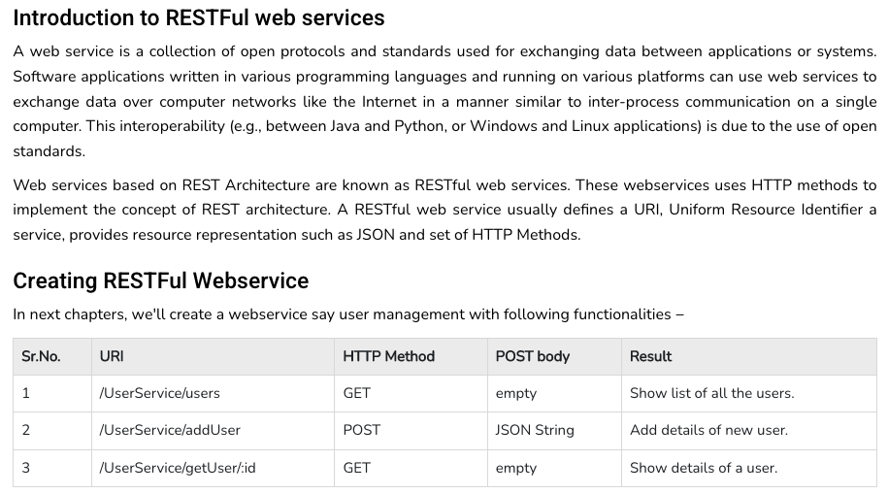
REST (https://www.tutorialspoint.com/restful/restful_introduction.htm)

Slide 62
REST and Resources

Slide 63
URLs

Slide 64
Simplistic, Conceptual Mapping (Examples)
REST Method | Resource Path | Relational Operation | DB Resource
DELETE | /people | DROP TABLE | people table
POST | /people | INSERT INTO PEOPLE (...) VALUES(...) | people table people row
GET | /people/21 | SHOW KEYS FROM people ...; SELECT * FROM people WHERE playerID= 21 | people row
GET | /people/21/batting | SELECT batting.* FROM people JOIN batting USING(playerID) WHERE playerID=21
GET | /people/21/batting/2004_1 | SELECT batting.* FROM people JOIN batting USING(playerID) WHERE playerID=21 AND yearID=2004 AND stint=1

Slide 65
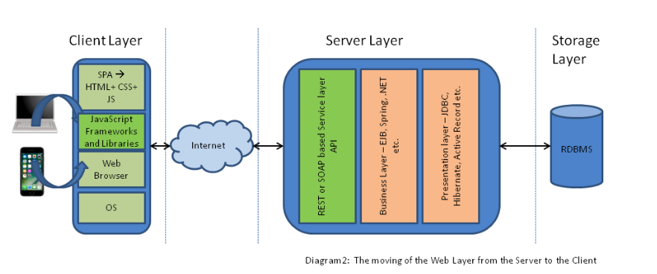
Application Architecture

Slide 66
Let’s Look at the Project

Slide 67
Relational Model
67 | COMS W4111_002_2025_1 - Lecture 5: ER(4), Relational(4), SQL(4) © Donald F. Ferguson, 2025

Slide 68
What are all those other Symbols?
Some of the operators are useful and “common,” but not always considered part of the core algebra.
Some of these are pretty obscure
Division
Anti-Join
Left semi-join
Right semi-join
Most SQL engines do not support them.
You can implement them using combinations of JOIN, SELECT, WHERE, ... ...
But, I cannot every remember using them in applications I have developed.
Outer JOIN is very useful, but less common. We will cover.
There are also some “patterns” or “terms”
Equijoin
Non-equi join
Natural join
Theta join
... ...
I may ask you to define these terms on some exams or the obscure operatorsbecause they may be common internships/job interview questions.
τ order by
γ group by
¬ negation
÷ set division
⨝ natural join, theta-join
⟕ left outer join
⟖ right outer join
⟗ full outer join
⋉ left semi join
⋊ right semi join
▷ anti-join

Slide 69
Thinking about JOINs
Some terms:
Natural Join
Equality of A and B columns
With the same name.
Equijoin
Explicitly specify columns that must have the same value.
A.x=B.z AND A.q=B.w
Theta Join: Arbitrary predicate.
Inner Join
JOIN “matches” rows in A and B.
Result contains ONLY the matched pairs.
What I want is:
All the rows that matched.
And the rows from A that did not match?
OUTER JOIN (⟖, ⟕)

Slide 70
What are all those other Symbols?
Some of the operators are useful and “common,” but not always considered part of the core algebra.
Some of these are pretty obscure
Division
Anti-Join
Left semi-join
Right semi-join
Most SQL engines do not support them.
You can implement them using combinations of JOIN, SELECT, WHERE, ... ...
But, I cannot every remember using them in applications I have developed.
Outer JOIN is very useful, but less common. We will cover.
There are also some “patterns” or “terms”
Equijoin
Non-equi join
Natural join
Theta join
... ...
I may ask you to define these terms on some exams or the obscure operatorsbecause they may be common internships/job interview questions.
τ order by
γ group by
¬ negation
÷ set division
⨝ natural join, theta-join
⟕ left outer join
⟖ right outer join
⟗ full outer join
⋉ left semi join
⋊ right semi join
▷ anti-join

Slide 71
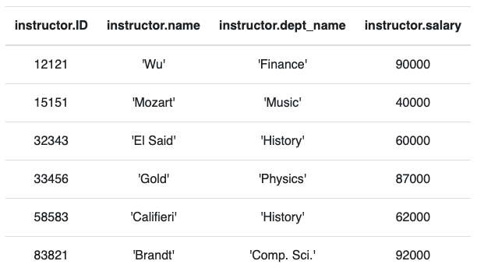
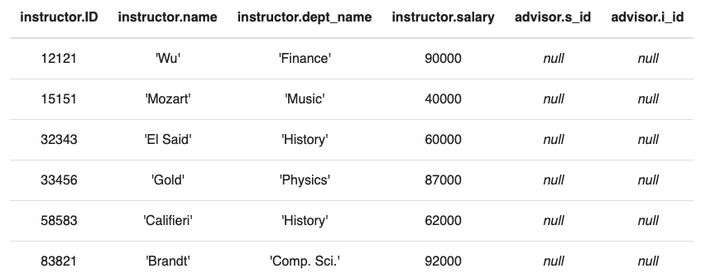
Anti – Join
“An anti-join is when you would like to keep all of the records in the original table except those records that match the other table.”
instructor ▷ ID=i_id advisor
σ i_id=null (instructor ⟕ ID=i_id advisor)

Slide 72
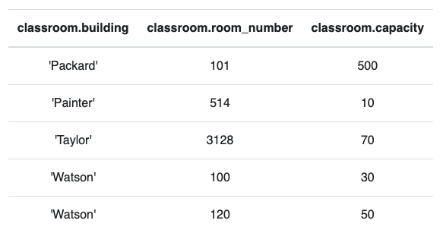
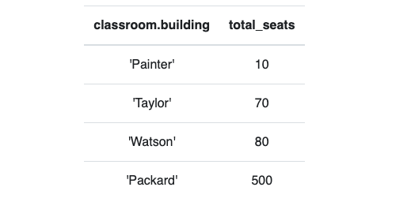
Group By, Order By
classroom
These are very simple examples.
We can apply them to relations created by operations on other tables.
τ total_seats (γ building; sum(capacity)→total_seats (classroom))

Slide 73
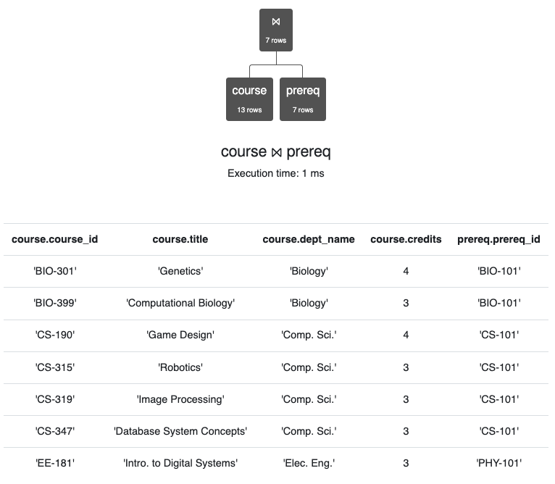
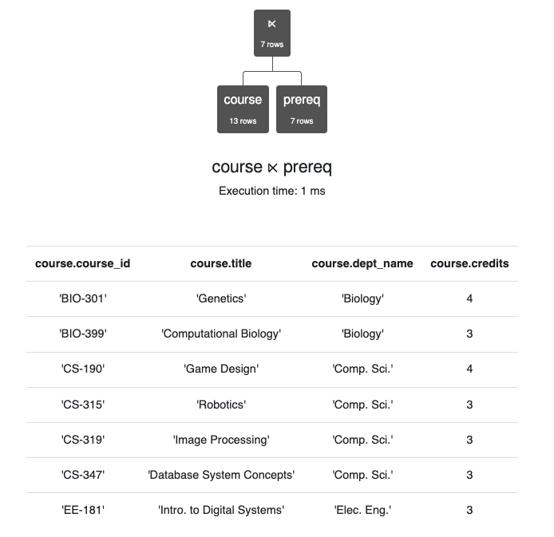
Semi-Join
Semi-join is a type of join that is applied to relations to join them based on the related columns. When semi-join is applied, it returns the rows from one table for which there are matching records in another related table.

Slide 74
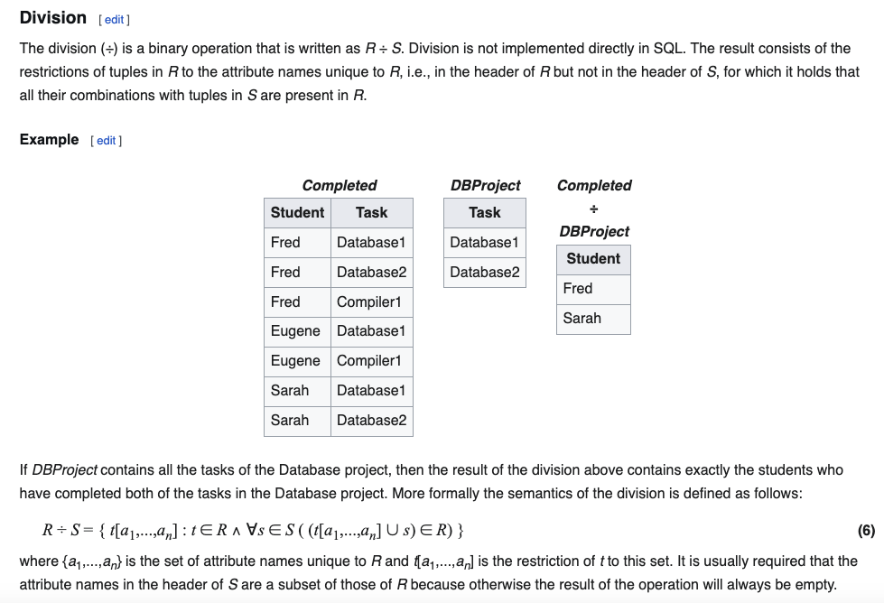
Division
Relax Example
X = π course_id←course_id (σ dept_name='History' (course))
Y = π ID←ID, course_id←course_id (student ⨝ takes)
Y ÷ X

Slide 75
SQL
75 | COMS W4111_002_2025_1 - Lecture 5: ER(4), Relational(4), SQL(4) © Donald F. Ferguson, 2025

Slide 76

Some Types and Functions
76 | COMS W4111_002_2025_1 - Lecture 5: ER(4), Relational(4), SQL(4) © Donald F. Ferguson, 2025

Slide 77
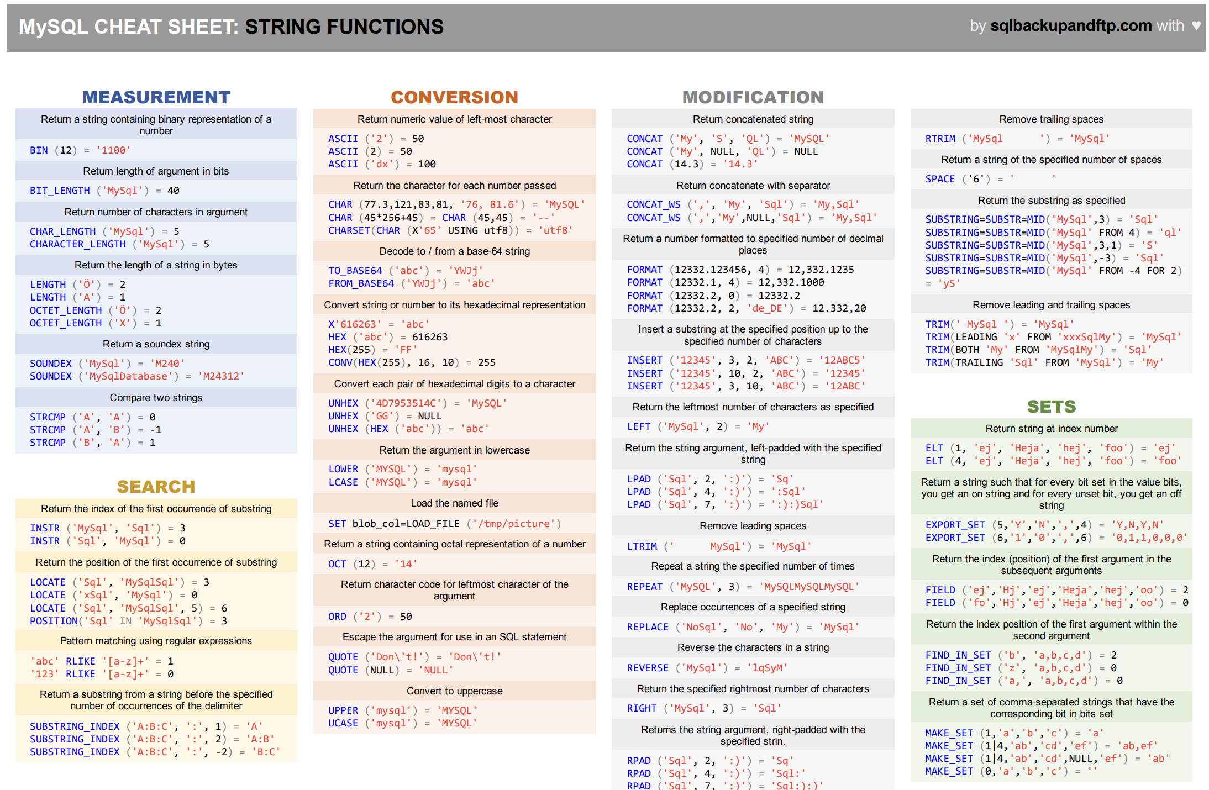
Functions

Slide 78
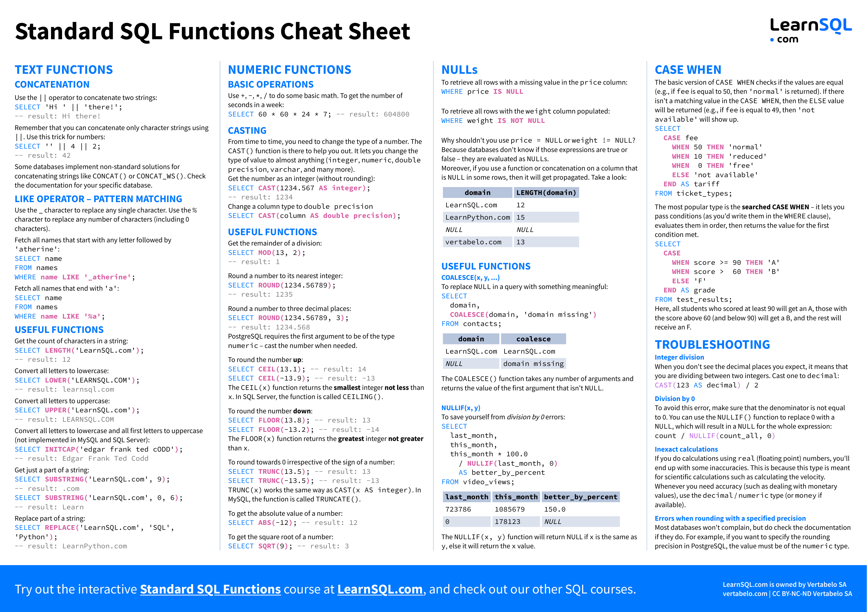
Functions

Slide 79
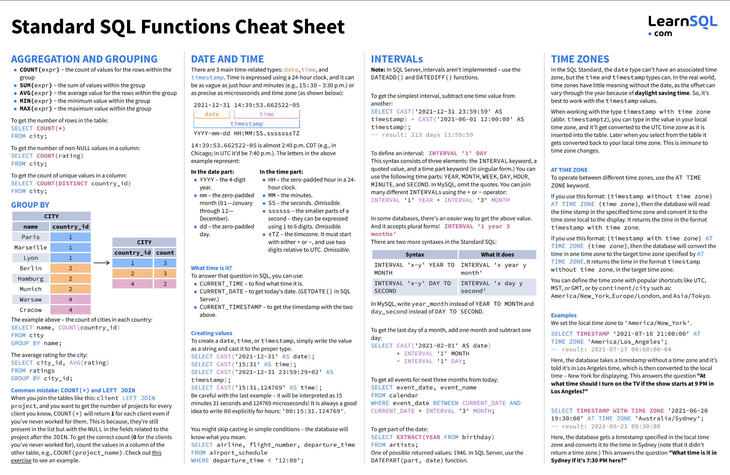
Functions

Slide 80
Functions
The are dozens if not hundreds of standard functions in SQL.
All DBMS implementations have product specific functions.
General rule:
If you have to do something, ask yourself
Am I the first one who ever had to do this?
If the answer is “No,” then ask Dr. Google/ChatGPT.
If the answer is Yes,” ask yourself, “Am I sure this is a good idea.”
The functions are useful and straightforward.
Some examples ➔ To the notebook we go, yo ho!

Slide 81
Indexes
81 | COMS W4111_002_2025_1 - Lecture 5: ER(4), Relational(4), SQL(4) © Donald F. Ferguson, 2025

Slide 82
Index Creation
Many queries reference only a small proportion of the records in a table.
It is inefficient for the system to read every record to find a record with particular value
An index on an attribute of a relation is a data structure that allows the database system to find those tuples in the relation that have a specified value for that attribute efficiently, without scanning through all the tuples of the relation.
We create an index with the create index command
create index <name> on <relation-name> (attribute);

Slide 83
Index Creation Example
create table student (ID varchar (5), name varchar (20) not null, dept_name varchar (20), tot_cred numeric (3,0) default 0, primary key (ID))
create index studentID_index on student(ID)
The query:
select * from student where ID = '12345'
can be executed by using the index to find the required record, without looking at all records of student
DFF:
An index on (column1, column2, column3)
Is also an index on (column1) and (column1, column2)
But not (column2), (column3), (column2, column3).
We will see “why” later in the semester.
Show performance in Notebook

Slide 84
Functions, Procedures and Trigger Concepts
84 | COMS W4111_002_2025_1 - Lecture 5: ER(4), Relational(4), SQL(4) © Donald F. Ferguson, 2025

Slide 85
Functions and Procedures
Functions and procedures allow “business logic” to be stored in the database and executed from SQL statements.
These can be defined either by the procedural component of SQL or by an external programming language such as Java, C, or C++.
The syntax we present here is defined by the SQL standard.
Most databases implement nonstandard versions of this syntax.
Note:
The programming language, runtime and tools for functions, procedures and triggers are not easy to use.
My view is that calling external functions is an anti-pattern (bad idea).
External code degrades the reliability, security and performance of the database.
Databases are often mission critical and the heart of environments.

Slide 86
Language Constructs for Procedures & Functions
SQL supports constructs that gives it almost all the power of a general-purpose programming language.
Warning: most database systems implement their own variant of the standard syntax below.
Compound statement: begin … end, {}
May contain multiple SQL statements between begin and end.
Local variables can be declared within a compound statements
While and repeat statements:
while boolean expression do
sequence of statements ;
end while
repeat
sequence of statements ;
until boolean expression
end repeat

Slide 87
(Core) Language Constructs (Cont.)
For loop
Permits iteration over all results of a query
Example: Find the budget of all departments declare n integer default 0; for r as select budget from department where dept_name = 'Music' do set n = n + r.budget end for
Note:
There are various other looping constructs.

Slide 88
(Core) Language Constructs – if-then-else
Conditional statements (if-then-else)
if boolean expression then statement or compound statement elseif boolean expression then statement or compound statement else statement or compound statement end if
Note:
We will not spend a lot of time writing functions, procedures, or triggers.
The language and development environment are not easy to use.

Slide 89
Functions
89 | COMS W4111_002_2025_1 - Lecture 5: ER(4), Relational(4), SQL(4) © Donald F. Ferguson, 2025

Slide 90
Declaring SQL Functions
Define a function that, given the name of a department, returns the count of the number of instructors in that department.
create function dept_count (dept_name varchar(20)) returns integer begin declare d_count integer; select count (* ) into d_count from instructor where instructor.dept_name = dept_name return d_count; end
The function dept_count can be used to find the department names and budget of all departments with more that 12 instructors.
select dept_name, budget from department where dept_count (dept_name ) > 12

Slide 91
Table Functions
The SQL standard supports functions that can return tables as results; such functions are called table functions
Example: Return all instructors in a given department
create function instructor_of (dept_name char(20))
returns table (
ID varchar(5), name varchar(20), dept_name varchar(20), salary numeric(8,2))
return table (select ID, name, dept_name, salary from instructor where instructor.dept_name = instructor_of.dept_name)
Usage
select * from table (instructor_of ('Music'))

Slide 92
Procedures
92 | COMS W4111_002_2025_1 - Lecture 5: ER(4), Relational(4), SQL(4) © Donald F. Ferguson, 2025

Slide 93
SQL Procedures
The dept_count function could instead be written as procedure:
create procedure dept_count_proc (in dept_name varchar(20), out d_count integer) begin
select count(*) into d_count from instructor where instructor.dept_name = dept_count_proc.dept_name
end
The keywords in and out are parameters that are expected to have values assigned to them and parameters whose values are set in the procedure in order to return results.
Procedures can be invoked either from an SQL procedure or from embedded SQL, using the call statement.
declare d_count integer; call dept_count_proc( 'Physics', d_count);

Slide 94
SQL Procedures (Cont.)
Procedures and functions can be invoked also from dynamic SQL
SQL allows more than one procedure of the so long as the number of arguments of the procedures with the same name is different.
The name, along with the number of arguments, is used to identify the procedure.

Slide 95
Triggers
95 | COMS W4111_002_2025_1 - Lecture 5: ER(4), Relational(4), SQL(4) © Donald F. Ferguson, 2025

Slide 96
Triggers
A trigger is a statement that is executed automatically by the system as a side effect of a modification to the database.
To design a trigger mechanism, we must:
Specify the conditions under which the trigger is to be executed.
Specify the actions to be taken when the trigger executes.
Triggers introduced to SQL standard in SQL:1999, but supported even earlier using non-standard syntax by most databases.
Syntax illustrated here may not work exactly on your database system; check the system manuals
X on T
before insert
before update
before delete
after insert
after update
after delete

Slide 97
Triggering Events and Actions in SQL
Triggering event can be insert, delete or update
Triggers on update can be restricted to specific attributes
For example, after update of takes on grade
Values of attributes before and after an update can be referenced
referencing old row as : for deletes and updates
referencing new row as : for inserts and updates
Triggers can be activated before an event, which can serve as extra constraints. For example, convert blank grades to null.
create trigger setnull_trigger before update of takes referencing new row as nrow for each row when (nrow.grade = ' ') begin atomic set nrow.grade = null; end;

Slide 98
Trigger to Maintain credits_earned value
create trigger credits_earned after update of takes on (grade) referencing new row as nrow referencing old row as orow for each row when nrow.grade <> 'F' and nrow.grade is not null and (orow.grade = 'F' or orow.grade is null) begin atomic update student set tot_cred= tot_cred + (select credits from course where course.course_id= nrow.course_id) where student.id = nrow.id; end;

Slide 99
Statement Level Triggers
Instead of executing a separate action for each affected row, a single action can be executed for all rows affected by a transaction
Use for each statement instead of for each row
Use referencing old table or referencing new table to refer to temporary tables (called transition tables) containing the affected rows
Can be more efficient when dealing with SQL statements that update a large number of rows

Slide 100
When Not To Use Triggers
Triggers were used earlier for tasks such as
Maintaining summary data (e.g., total salary of each department)
Replicating databases by recording changes to special relations (called change or delta relations) and having a separate process that applies the changes over to a replica
There are better ways of doing these now:
Databases today provide built in materialized view facilities to maintain summary data
Databases provide built-in support for replication
Encapsulation facilities can be used instead of triggers in many cases
Define methods to update fields
Carry out actions as part of the update methods instead of through a trigger

Slide 101
When Not To Use Triggers (Cont.)
Risk of unintended execution of triggers, for example, when
Loading data from a backup copy
Replicating updates at a remote site
Trigger execution can be disabled before such actions.
Other risks with triggers:
Error leading to failure of critical transactions that set off the trigger
Cascading execution

Slide 102
Summary
102 | COMS W4111_002_2025_1 - Lecture 5: ER(4), Relational(4), SQL(4) © Donald F. Ferguson, 2025

Slide 103
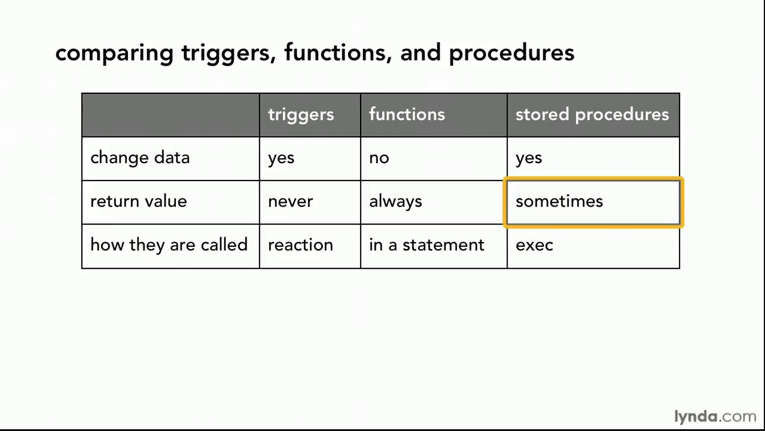
Comparison

Slide 104
Comparison – Some Details
A trigger has capabilities like a procedure, except ...
You do not call it. The DB engine calls it before or after an INSERT, UPDATE, DELETE.
The inputs are the list of incoming new, modified rows.
The outputs are the modified versions of the new or modified rows.

Slide 105
Let’s Do an Example Pulling Together Some Concepts
105 | COMS W4111_002_2025_1 - Lecture 5: ER(4), Relational(4), SQL(4) © Donald F. Ferguson, 2025

Slide 106
Switch to Notebook

Slide 107
Backup

